Slide 1
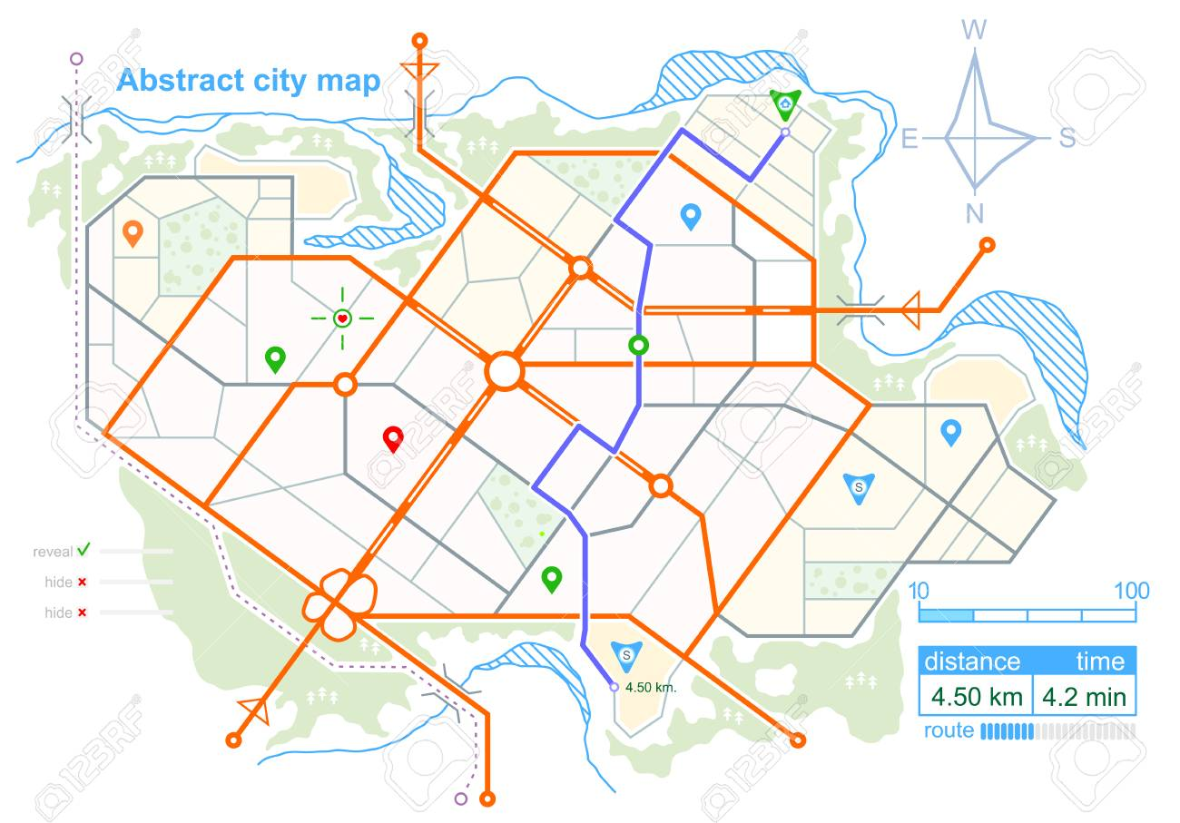
General Hospital
Home
About Us
Locations
Services
Patients & Families
Find a Doctor
Contact Us
Welcome to General Hospital!
Quick Links
Pay a Bill
myGH
Specialty Care
123 Hospital Drive
Generaltown, AB 45678
(123) 546-7890
info@generalhospital.org
News & Announcements

Slide 2
General Hospital
Home
About Us
Locations
Services
Patients & Families
Find a Doctor
Contact Us
Patients & Families
Your Hospital Stay
You, your family, and your Care Partner(s) are essential members of the health care team. Working together with you and taking the time to listen to your goals, concerns, and needs builds understanding among all members of the health care team and helps us develop the best plan of care with you. During your stay, we encourage your participation by urging you to speak up, ask questions, and use our resources.
Your Health Care Team [create a page describing different roles, including Care Partners]
Your Care Partners [see sample page]
When you arrive at the hospital, we will ask if you want to identify one or two people to be Care Partners [or you can substitute other terms such as support person]. These are family/friends whom you want to be actively involved in your care during your hospital stay and the transition back home. You decide how much you want them to be part of your care.
Visiting Information
[see sample page]
Your Electronic Medical Record [Patient Portal]
Safety and Quality
Educational Programs, Peer Support, and Other Resources
Patient- and Family-Centered Care
Typically, your Care Partner(s) can be with you at any time, day or night, without restriction. Other than you, they will be the main contact for your health care team. The team will update your Care Partner who can then update family and friends about your progress and communicate your wishes to them.
More information about Care Partners
Billing and Insurance
Services and Amenities

Slide 3
General Hospital
Home
About Us
Locations
Services
Patients & Families
Find a Doctor
Contact Us
Your Care Partners
Your Hospital Stay
It is helpful if you identify a Care Partner, a family member or friend who will be a support person for you and will be a key member of your health care team, together with you and doctors, nurses, and other staff. You can have more than one Care Partner. Their involvement will ensure better care, safety, and outcomes. They have an important role as spokesperson, advocate, and supporter, especially if you are too sick or overwhelmed to “speak up” for yourself.
Together, you and your Care Partners can learn about care during a hospital stay, gain confidence in providing care, and plan for the transition to home. It is helpful if your Care Partner, according to your preferences, participates with you in nurse change of shift report, rounds, and discharge planning meetings when important information is discussed and your care is planned. Your Care Partner(s) may help you with managing your medications, getting to appointments, and other aspects of your care and recovery after you leave the hospital.
Your Health Care Team [create a page describing different roles, including Care Partners]
Your Care Partners
Visiting Information
[see sample page]
Your Electronic Medical Record [Patient Portal]
Safety and Quality
Educational Programs, Peer Support, and Other Resources
TOGETHER: Tips for Care Partners
Patient- and Family-Centered Care
Talk about your role with your loved one. Introduce yourself to staff and describe your relationship to the patient and how you’d like to participate in care.
Observe changes (physical, behavioral, emotional) in the patient and report them to health care providers. Ask staff what observations they would like you to routinely share.
Gather helpful information (current medications, medical history, other health care providers, and insurance) and bring it all to the hospital.
Ensure that you’re present, if possible, at times when information will be shared and decisions need to be made. Keep your schedule for coming to the hospital manageable. Let staff members know how to reach you and be sure you know whom to contact for information when you’re away from the bedside.
Tell staff if you have any concerns about the patient’s condition or safety or if you are uncomfortable because “something just doesn’t feel right.”
Billing and Insurance
Services and Amenities
(continued on next page)

Slide 4
Help with decision-making about care and treatment. Be a second set of eyes and ears for the patient. Ask questions and take notes. Encourage your loved one to participate in decision-making to the extent he or she chooses.
Enlist help from staff members with whom you are comfortable so that they can support you and your loved one as you participate in care and decision-making.
Ready yourself for the transition to home or community care. Before you leave the hospital, make sure your questions and those of the patient have been answered. Know what will be needed afterwards (medications, treatment, equipment, follow-up appointments) and what changes in the patient’s condition should be reported to health care providers.

Slide 5
General Hospital
Home
About Us
Locations
Services
Patients & Families
Find a Doctor
Contact Us
Visiting Information
Your Hospital Stay
Visiting Information
We welcome visitors—guests of the patient and their Care Partner(s)—because we believe visitors are important to patients’ recovery. We also recognize that patients need to rest in order to get better so we ask that visitors follow the wishes of the patient and their Care Partner(s) regarding visiting as well as the following Visiting guidelines.
General visiting hours at __________ Hospital are from ___ a.m. to ___ p.m. When you arrive to visit your loved one or friend, please stop at the Information Desk located in the main lobby where ____________ will help you with any questions you may have. Even if you
Your Health Care Team [create a page describing different roles, including Care Partners]
Your Care Partners [see sample page]
Visiting Information
Your Electronic Medical Record [Patient Portal]
Safety and Quality
Educational Programs, Peer Support, and Other Resources
have been visiting your patient regularly we kindly ask you to do this so you will know your patient’s current room number and be informed of any visiting restrictions that may be in effect.
To maintain a restful, healing environment we ask that all visitors leave the hospital by ____ p.m. Designated Care Partners may stay with patients 24 hours and do not have to leave at ____ p.m. A Care Partner is someone whom a patient has identified to be an active member of the health care team. You can find more information here.
Patient- and Family-Centered Care
Billing and Insurance
Services and Amenities
Siblings & Children
[Hospital’s policy on siblings and children would go here.]
Safety Precautions
Health and safety of patients are our primary concerns. We ask that visitors as well as Care Partners please help keep their loved one safe by following these basic precautions when they come to the hospital. These precautions may help safeguard your health as well.
[Include specific “precautions” about colds, flu season, latex, etc.]

