Slide 2
Creating Capacity for Sustainable Partnerships with Patients and Families in Research
Training for
Researchers and Staff
(Date)
IPFCC
These materials were developed as part of a project funded by a PCORI Engagement Award: EA-1467-IPFCC. May be used for educational purpose with permission from IPFCC.

Slide 3
Training Objectives
Identify the benefits of patient and family engagement in research.
Recognize opportunities for patient and family engagement in research partnerships.
Determine how to engage advisors, patient and family advisory councils, and community in your project/s.
Notes:
For reference

Slide 4
Advisor Engagement in research

Slide 5
Patient-Centered Outcomes Research (PCOR)
Helps people and their caregivers communicate and make informed health care decisions, allowing their voices to be heard in assessing the value of health care options.
Actively engages patients and key stakeholders throughout the research process.
Evaluates the outcomes that are most important to patients.
Addresses dissemination of the research findings in clinical care environments.
Notes:
Key Points
PCOR takes into account the preferences, values, and experiences of individual patients or groups of patients and weaves them into the research process. The research looks to examine questions such as: “Will this treatment improve the quality of a patient’s or a family caregiver’s life? Given lifestyle and preferences, which options are best for a patient? How will the implications of a particular treatment, medicine affect a patient or a family?”

Slide 6
Clinical Care
Research
Education
Governance
Patient, Family & Community Partnership
Notes:
Key Points
How do we engage them – encouraging them to be present, have good communication, can self-manage (that’s the end goal), to participate as PFCC advisors.
Patient and family advisors whether in PFACs or on committees/work groups can partner in improving and enhancing all these areas.

Slide 7
Patient- and Family-Centered Care Core Concepts
People are treated with respect and dignity.
Health care providers communicate and share complete and unbiased information with patients and families in ways that are affirming and useful.
Patients and families are encouraged and supported in participating in care and decision-making at the level they choose.
Collaboration among patients, families, and providers occurs in policy and program development and professional education, as well as in the delivery of care.
Notes:
As background to our work, Core Concepts from the Institute for Patient- and Family-Centered Care:
Dignity and Respect. Health care practitioners listen to and honor patient and family perspectives and choices. Patient and family knowledge, values, beliefs, and cultural backgrounds are incorporated into the planning and delivery of care.
Information Sharing. Health care practitioners communicate and share complete and unbiased information with patients and families in ways that are affirming and useful. Patients and families receive timely, complete, and accurate information in order to effectively participate in care and decision-making. It is a two-way street. They are also given opportunities to share information with clinicians and staff that they believe is important for their care.
Participation. Patients and families are encouraged and supported in participating in care and decision-making at the level they choose – throughout the health care experience. It may change so providers need to be responsive to the choices that patients and families make.
Collaboration. Patients, families, health care practitioners, and health care leaders collaborate in policy and program development, implementation, and evaluation; and in professional education.

Slide 8
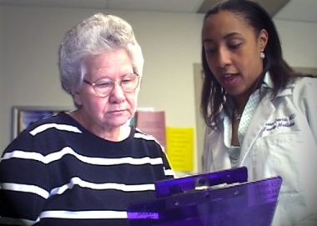
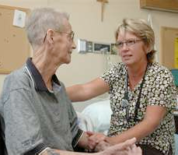
Patient- and family-centered care is working "with" patients and families, rather than just doing "to" or "for" them.
Notes:
Key Points
Redefines the relationships in health care
Essential shift – from the way care is delivered and health care is designed and transformed – with and not to or for.
Grounded in mutually beneficial partnerships
Applies to partnerships in research – partnering with patients and families to plan, conduct, and use the results to improve health care for all.

Slide 9
Why Engage Patients and Family Members in Research?
They make decisions about health and health care all the time.
They know what is right for them.
They know what they want to accomplish with their life.
They recognize that health care is only one part of life.
They want to improve health and wellness for others.
Notes:
Key Points
Their expertise is in being an expert in their health and their experience of health care and the health care system.
They can bring a lot of context to a conversation about research.
The fact that they serve on a PFAC currently demonstrates their passion for helping improve care for others

Slide 10
Patient and Family Advisors - Contributions to Research
Bring real-world experience, wisdom, and passion.
Create trust and relationships between researcher/institution and patient/community groups.
Better utilization of resources with “first time quality.”
Better communication and information dissemination.
More relevant and rewarding research – results are meaningful to the end-user.
Share what feels right and what matters.
Notes:
Key Points
Increased relevance of research – topics not chosen by researcher based solely on intellectual/professional interests but integrates concerns/interests of patients and family members
Decreased time and effort expended in recruiting research subjects – stakeholder partners tap into networks and encourage participation
Increased research rigor – larger sample size of voices add to greater weight of results – especially if can get people who do not typically opt to participate in research
Increased trust and relationships in research institutions among community
Increased dissemination and utilization of research findings - create faster more efficient way of getting from bench to bed/clinic
Increased cultural understanding and competency
Increased satisfaction when research breakthroughs create immediate, relevant and meaningful differences in day-to-day lives

Slide 11
Partnership Not Power Shift
Investigator
Professional expertise; intellectual curiosity
Advisor
Totality of experience; real-world and relevant
“What is best for me and my family?”
Notes:
Key Point
To summarize – everyone is bringing their expertise and expertise to the research project
Dispel any concerns either party may have

Slide 12
Advisor Engagement opportunities

Slide 13
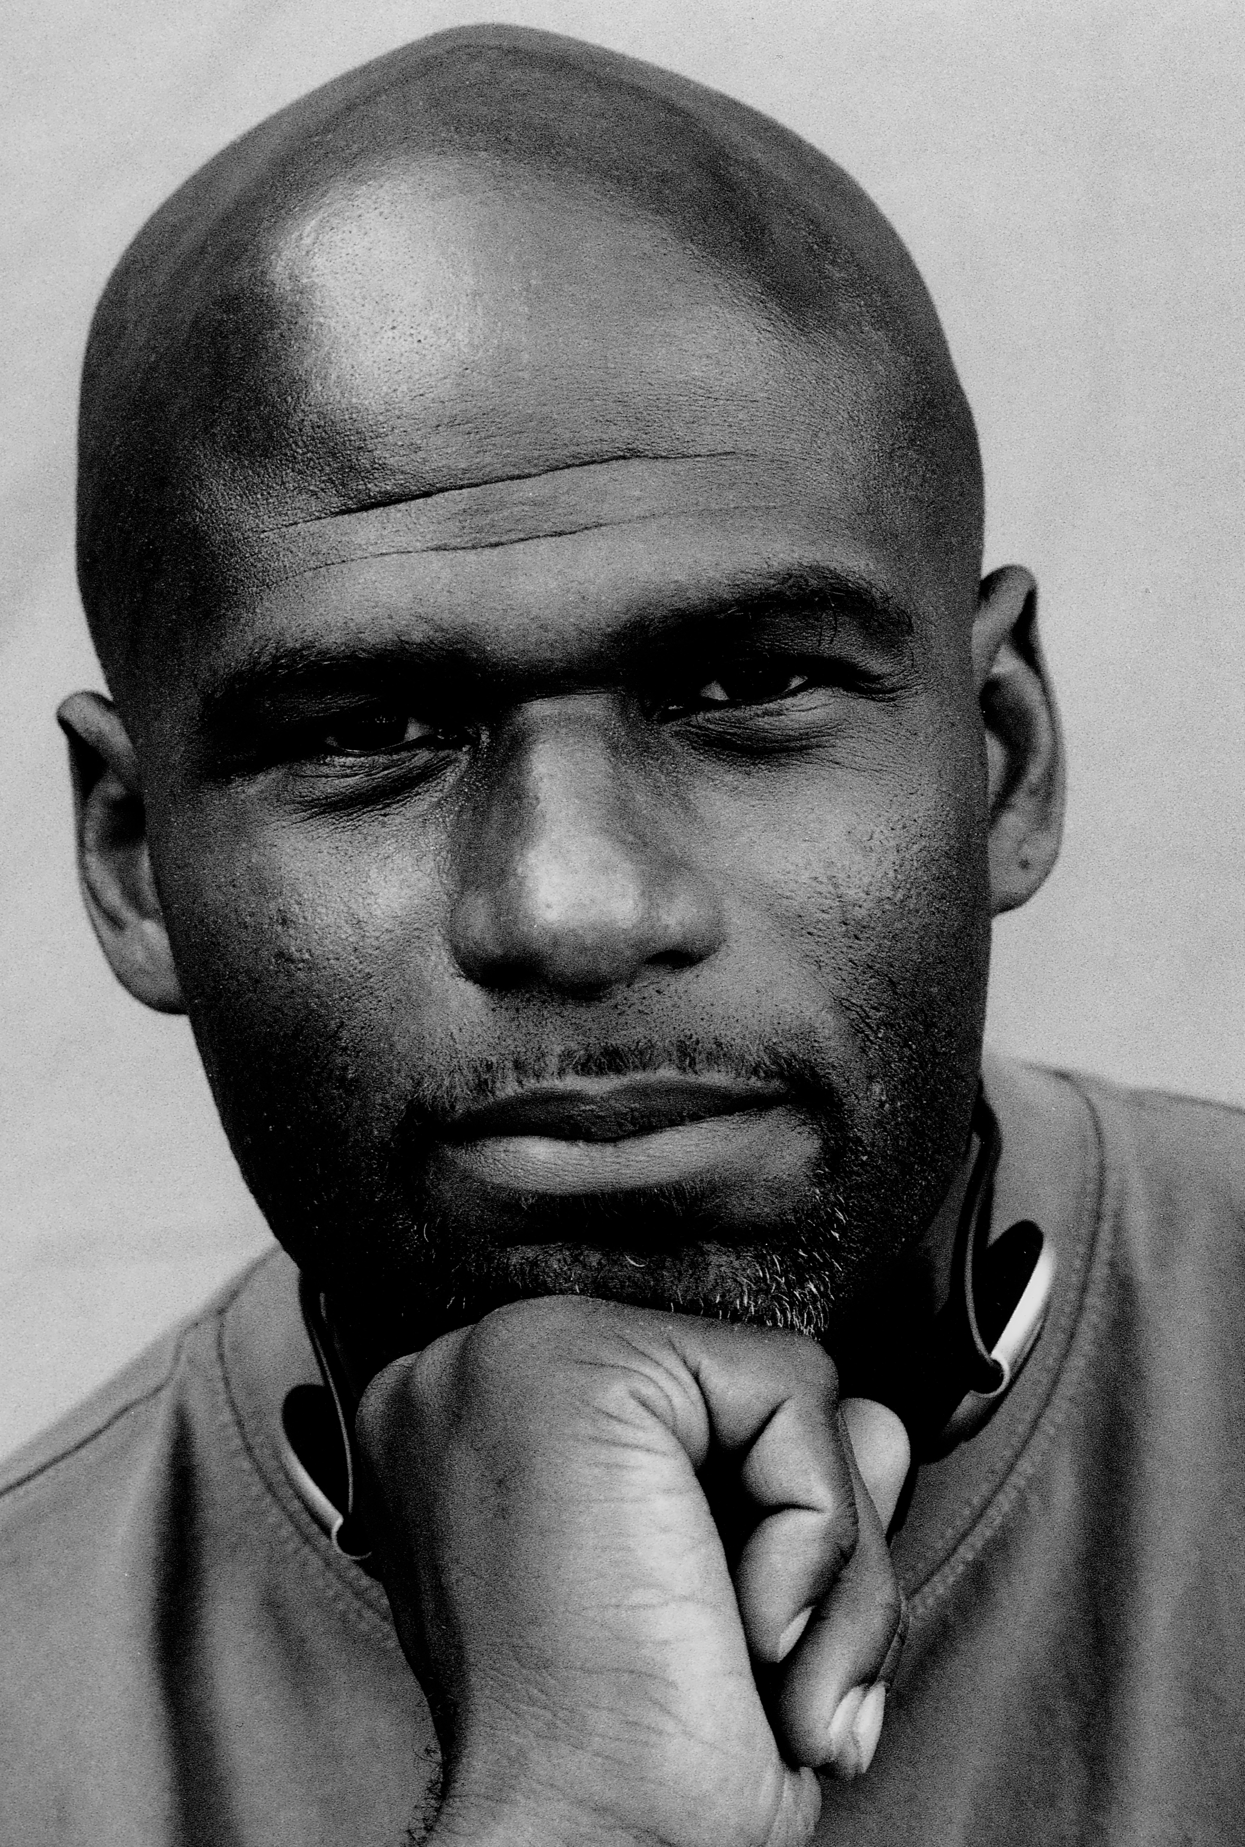
Who Are Your Patients?
Notes:
Key Point
Culture is an integration of patterns of behavior can include communication, rituals, roles, language, relationships, manners of interacting, beliefs and expected behavior It is applicable to all people. Everyone has a culture or norms that happen within your group. For instance, how you celebrate holidays; rituals and traditions around weddings, births and dying.

Slide 14
Patient and Family Advisors
Share wisdom and advise based on personal health care experiences.
Partner with staff and faculty to influence the care and services provided to patients, families, and community.
Advisor forums and groups are not complaint sessions, support groups, or therapy.

Slide 15
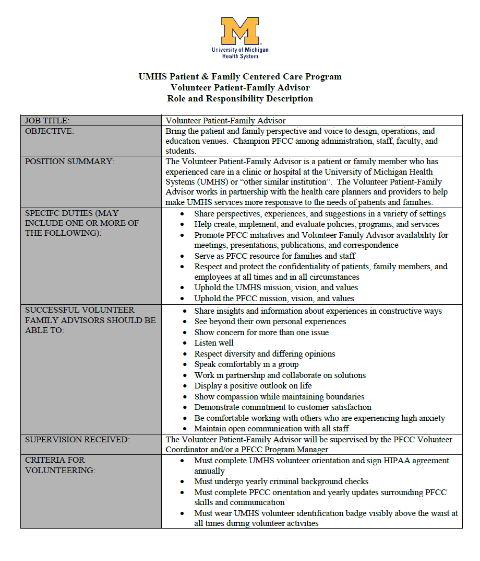
Successful Volunteer Advisors
Respectful
Active listener
Flexible
Open-minded
Patient
Thoughtful
Calm
Solution-oriented
Represent broad perspective
Notes:
Key Points
Patient and family advisors who are selected to serve on advisory councils embody these characteristics.
They receive orientation and training that support them in being effective partners with health care professionals.
This background will be invaluable to your research efforts.

Slide 16
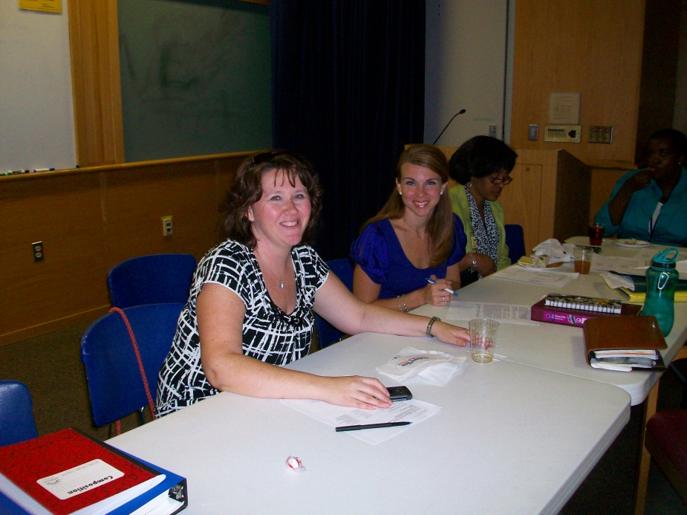
Selecting and Supporting Advisors
Recruitment
Interview
Background Check
Volunteer Orientation
PFCC Education
Placement and Training
Other Special Training
Ongoing Support and Education
Notes:
Key Point:
Advisors are carefully selected and receive orientation and ongoing mentoring. Check with the staff coordinator for the advisor program.

Slide 17
Patient and Family Advisory Council
The council is a partnership model consisting of at least equal numbers of patients and family members who have received care and staff and faculty members who have provided care at an institution.
The council provides a mechanism to:
Seek the patient and family voice
Promote a culture of patient- and family-centered care and guide its implementation through constructive feedback about programs, services, policies, and amenities
Enhance the delivery of high quality and safe care
Notes:
Question:
How familiar are you with the PFAC at your organization?
Note: If a representative of the council and/or staff coordinator of the council are in the meeting, ask them to describe the council.

Slide 18
E-Advisors
Share Thoughts
Complete Surveys
Review Materials
Online list of patients and family members who provide feedback
Utilize Qualtrics with anonymous hyperlink
Quick access and response
Not always a picture-perfect representation of those we serve
Notes:
Key Point:
Can tap into a broader advisor base if organization has an E-Advisor program

Slide 19
How Can Patient and Family Advisors Be Engaged?
INFORM
Simply informing
Study plans are communicated to the patient community
CONSULT
Consulting on decision
Offer opinions, advice and feedback
Serve as language lens
Decide together/act together
Joint decisions solicited
Taking actions jointly
COLLABORATE
STAKEHOLDER DIRECTED
Encouraging independent initiatives
Leading to patient-caregiver-community- generated research
PCORI Engagement Model
Notes:
Key Points
Different levels of involvement
May be involved in different projects at different levels – ask for example or give some examples
(Resource describing PCORI Engagement model is available to you)

Slide 20
Obtaining “the Voice”
Steering Committee
Patient Family
Project Workgroup
Virtual Advisors
Staff & Clinicians
Focus Groups
Community
Focus Groups
Town Halls
PFAC
Notes:
Key Points - Obtain the voice of many
Provider focus groups
Is your agency currently involved in research or clinical trials?
What topics do you believe are most important to support your patients and their families?
Do you have any suggestions for improvement?
Community town halls (4-5 open ended questions)
In person
Virtual
Conference calls
Online survey for those who cannot attend in person
Advisory council - provide a concrete way for a group to engage and go through a structured process around a topic

Slide 21
Overview Advisor and PFAC Engagement in Research Projects
Provide feedback about proposed research, discuss issues, resolve questions/concerns
Serve as language lens; review and provide feedback for materials and scripts
Communicate information about the study to community/patient organizations (aid in participant recruitment)
Share study findings with community/patient organizations and generate new ideas for future research
Pre-Study
Generate ideas for research, prioritize topics for study
Notes:
Key Points
Provide feedback and communication – share relevant experiences, voice concerns
Review and help develop/revise materials (for example: informed consents, decision aids, surveys, scripts)
Teach (grand rounds, CME, social media, town halls, PSA, community organizations)
Gather feedback from others – enroll and speak with those who don’t want to enroll – ask why? What are the obstacles? What else do we need to know about this topic?

Slide 22
“Just hearing about the process of engaging advisors doesn’t mean you know how to do it.”
Celene Wong, Project Manager
Center for Patients and Families
Brigham & Women’s Hospital

Slide 23
Guided Storytelling Methodology
What matters?
What unanswered questions do you have?
How will different choices affect your life?
Define quality.
Define a good day.
What do the findings mean for you/family?
Who needs to know?
How do we best inform those who need to know?
Notes:
Key Points
Have you used storytelling methodology before? How?
These are questions that are helpful to ask patient and family advisors.
Start asking these questions at the very beginning as you are thinking about a topic or research questions.

Slide 24
Seeking Funding
Advisory Councils/Advisors may help with:
Reviewing proposal
Writing a letter of support
Sharing personal stories with potential funding sources
Notes:
Key Points
At the point when you need to seek funding, you can engage advisors in this process. Make sure that advisors have been involved in the conceptualization of the study if you are asking them to assist with the funding.
Patient and family advisors can help funders understand from the patient/family perspective things such as:
The significance of the specific question the research is intended to inform
The specific population for whom the health decision is pertinent
How study results will inform health decisions, treatments, etc.
How it will impact the real lives of patients, families, communities…

Slide 25
Who Do You Call to…..?
Ask for a PFE letter of support
Engage an advisor to share “pertinent” story
Gain access to advisory council
Place advisors on a research project
Engage community
……
Notes:
Key Point:
Work with the staff coordinator of the PFAC and advisor program and the PFAC Co-Chairs to access advisors.

Slide 26
Contacting Your Advisor Program
(Name of staff who manages Advisors/PFAC)
(Email address)
(Phone Number)
Be prepared to provide the following information:
Brief description of research
Explanation of how you would like to engage the patient and family voice (i.e., advisor to join research project team, engage PFAC)
Experiences that you are looking for in advisors
Notes:
Key Point:
Work with the staff coordinator of the PFAC and advisor program and the PFAC Co-Chairs to access advisors.

Slide 27
Discussion

Slide 28
Have you already engaged advisors in research projects? How did that go?
How do you see this partnership benefiting outcomes?
How do you see yourself engaging patients, families, community in your work?
What concerns you?
Notes:
Discussion questions

Slide 29
Challenges for Researchers
Increased time
Establishing trust
Reaching consensus
Need to develop new skills
Increased feelings of frustration
Feeling criticized by stakeholders “letting off steam”
Feeling dependent when used to working independently
Increased funding requirements – compensating advisors
Increased institutional barriers – compliance, IRB, legal
Concern over scientific rigor – strength of design
Notes:
Key Points
This list is what we hear when we talk to people who are beginning partnerships in research.
Some of these are things we hear from health care professionals before any partnership or in the beginning stages.
Can plan to address the challenges when we know them.

Slide 30
Keeping Connected: PFAC Network
http://pfacnetwork.ipfcc.org/main/summary
Notes:
You can join a discussion board that welcomes all members of research teams.

Slide 31
Lessons learned

Slide 32
1. Provide Specialized Advisor Training as Needed
General Advisor
General Volunteer Orientation HIPAA, Code of Conduct, Organizational Mission and Values
Research Basic + Beyond
Research Basics – research defined, terminology, design, methodology, data
Project-Specific
Introduction to Research Team
PFCC "101" Orientation
How to Be An Effective Advisor
Effective Communication Skills
Potential Challenges
Raising Difficult Issues
Recognizing Boundaries
Sharing Your Story
Stages of Research
Collaborative Approaches to Research
Decision-Making Process
Role of the PFA or PFAC in Research
Potential Challenges for PFAs Participating on Research Teams
Human Subject Issues and IRB
Orient to Project – Purpose, objectives, design, methodology
Terms and Acronyms
Project Phases
Quality Improvement vs. Research
Desired Outcomes
Expectations for PFA - meeting/call schedule, anticipated work beyond meetings, compensation
Understanding Data
Role of PFA
Notes:
Key Points
Advisors receive training – some they will already have within their general advisor role and some you as a researcher can provide as needed:
Research Basic + Beyond – basic research framework, stages, etc., (refer to the PFAC Initial Training Slide Deck)
Project specific – as you work with a PFAC, you may need to give them more information so that the PFAC is ready to be the best advisors for the project. If you decide that there will be a PFAC subcommittee that will work with you more intensely or some members of the PFAC are invited to serve on a research team, keep this list in mind. Plan with with the advisors how best to prepare them for the specific project.

Slide 33
2. Prepare Research Committees for Advisor Participation
Inform researcher how to access PFAC or other advisors.
Attend research team meeting before they meet with PFAC.
Define goals and expectations of PFAC involvement.
Discuss expectations of PFAC – including training and HIPAA compliance.
Discuss expectations of researchers – including how to be welcoming, inclusive, and empowering.
Discuss who to contact if there is inappropriate interactions, if there are challenges, or it is “just not a good fit.”
Ask about concerns about PFAC involvement with researchers and address them.
Notes:
Key Point
This is for the staff coordinator and the PFAC co-chairs. As researchers you can ensure that these are discussed so that everyone is prepared for the participation of patient and family advisors.

Slide 34
3. Run Effective Meetings with PFAs
Make reminder calls for meeting attendance and send materials in advance.
Hold meetings in familiar and comfortable place.
Engage in a personal check in of important life events during the first 5-10 minutes of every meeting.
Engage in adult learning strategies and activities.
Establish an open door policy before and after each meeting for advisors to check in and express concerns/ask questions.
Keep agendas practical and follow them.
Create a community and nurture trust.
Notes:
Key Point
You all probably are very skilled at running effective meetings with your colleagues. These are a few things that are essential when working with patient and family advisors.

Slide 35
4. Create Community and Build Trust - Researcher Roles and Responsibilities
Build Relationships
Devote time to getting to know the advisors.
Provide Direction
Develop a structure that allows everyone's ideas to be heard.
Ask questions.
Provide Motivation
Plan the agenda recognizing that everyone has a strength.
Shape the Path
Recap progress, where to next, and plan for getting there.
Determine problems and remove obstacles.
Notes:
Key Point
What we learned from our work in building partnerships among patients, families, and health care professionals and what our best practice sites told us in interviews. This takes time but is necessary to nurture.

Slide 36
5. Support Between Meetings Engagement with Online Networks
Social Network
Twitter, Facebook, and Instagram, Regularly scheduled chats, and blogs
Scholarly Network
Google Groups, LinkedIn, IPFCC’s PFAC Network, and Webinars
Regularly scheduled research updates
Notes:
Key Point
Keep advisors engaged in between meetings
Details
Instagram
Pros: visual showcase, teaser for more information share updates and resources via embedded links, mobility
Cons: no direct collaboration feature, requires users to find each other to connect, not all research has relevant visuals
Facebook
Pros: most people already use it, secured networking, group/page forming capabilities to create a hub, mobility
Cons: no file/resource sharing feature (unless resource is linked through the internet), no group chat feature
Twitter
Pros: promotes conversation, connects groups through hashtags, share updates and resources via embedded links, easy to find peers outside of PCORI community, mobility
Cons: completely open network (anyone can see your posts, not just the people you are targeting), limited text feature
Google Groups
Pros: Document sharing hub, collaborative work, group chat, useful document settings, notification of updates by others
Cons: less than optimal mobility, less social
Linked In
Pros: most people are on it, closed groups, professional network building made easy, social networking space
Cons: not built as a document-sharing platform

Slide 37
6. Compensate
Out-of-Pocket Expenses: travel, childcare
Gift/Gas Cards, Food
Stipends and Honorariums: Hourly, Daily, Yearly
Recognizes advisors and community members as valuable contributors to research projects.
For a detailed discussion of compensation, visit: www.pcori.org/blog/framework-financial-compensation-patient-partners-research
Notes:
Key Points
Reflects expectations, skill level, and time commitment as well as level of engagement
Does the member make decisions, take action?
Is the member expected to work independently?
Considers local prevailing wages and cost-of-living expenses.

Slide 38
7. Engage IRB
Do patient and family advisors have access to human subject data?
Do they have responsibility in keeping subjects safe/upholding research ethics?
What are our responsibilities to make sure that they are trained appropriately?
Notes:
Key Point
Consider whether advisors need training but be creative in the training. Make it educational and interactive.
There are some innovative programs out there now.

Slide 39
8. Evaluate the Partnership from Advisor Perspective
Engagement and Training
How was your attendance? Were there obstacles to attend as much as you wanted?
Were you given knowledge and support needed to be effective?
Did you understand your role and expectations?
Project Work
Were goals achieved?
What was accomplished?
How well did people communicate?
Did you feel heard and respected?
Notes:
Key Point for next two slides:
Assess the effectiveness and quality of the partnership process, level of PFAC involvement, and ideas for improvement. Key questions that researchers and staff coordinators of the advisor program should be asking advisors to understand their perspective.

Slide 40
8. Evaluate the Partnership from Advisor Perspective (cont.)
Value and Meaning
Were your needs met?
What did you like least? Best?
Would you participate in similar venue again?
What would you change?
New Directions?
Are there unanswered questions?
Should this be tested in different populations or care settings?
Did this bring up new questions and issues?

Slide 41
8b. Metrics to Evaluate Effectiveness of Advisors
Committee/Project Effectiveness
Number of advisors on PFAC/Research committees
Number of ideas generated by advisors
Number of advisor-generated ideas used in research projects
Results related to advisor participation (e.g., # study participants enrolled; # community forums to talk about study)
Patient Satisfaction/Experience (related to study)
Patient Safety and Quality (related to study)
Notes:
Key Point:
Assess the difference it made in having advisors involved as partners in the research study.

Slide 42
IPFCC’s Online Toolbox for Creating Sustainable Partnerships with Patients and Families in Research
www.ipfcc.org/bestpractices/index.html
Notes:
A comprehensive online Toolbox is available from IPFCC.

